Slide 1
Getting Started Google CoLab

Slide 2
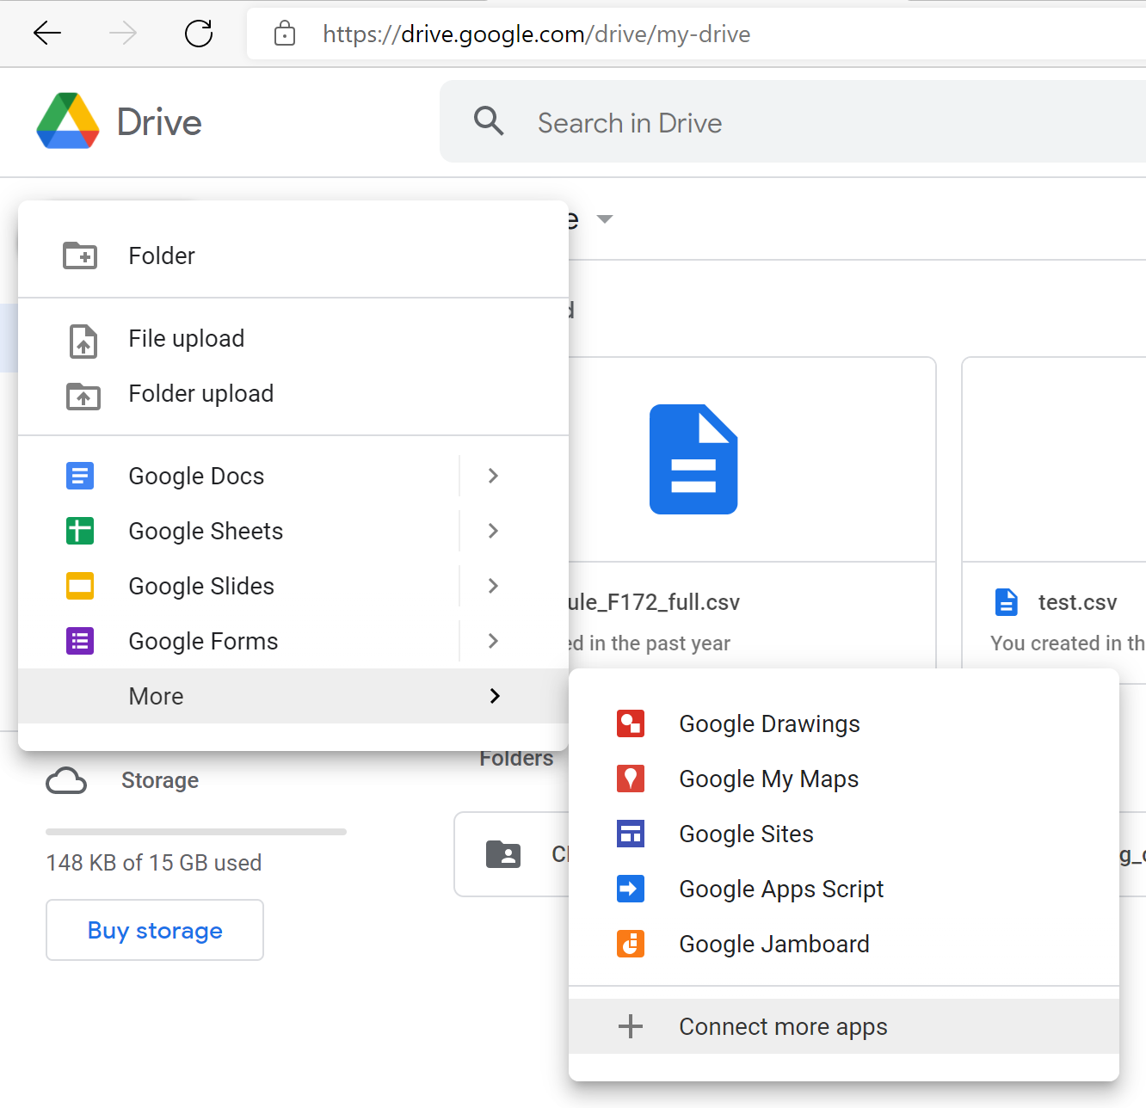
In google drive,
click “New”
then “More”,
then “Connect more apps”.

Slide 3
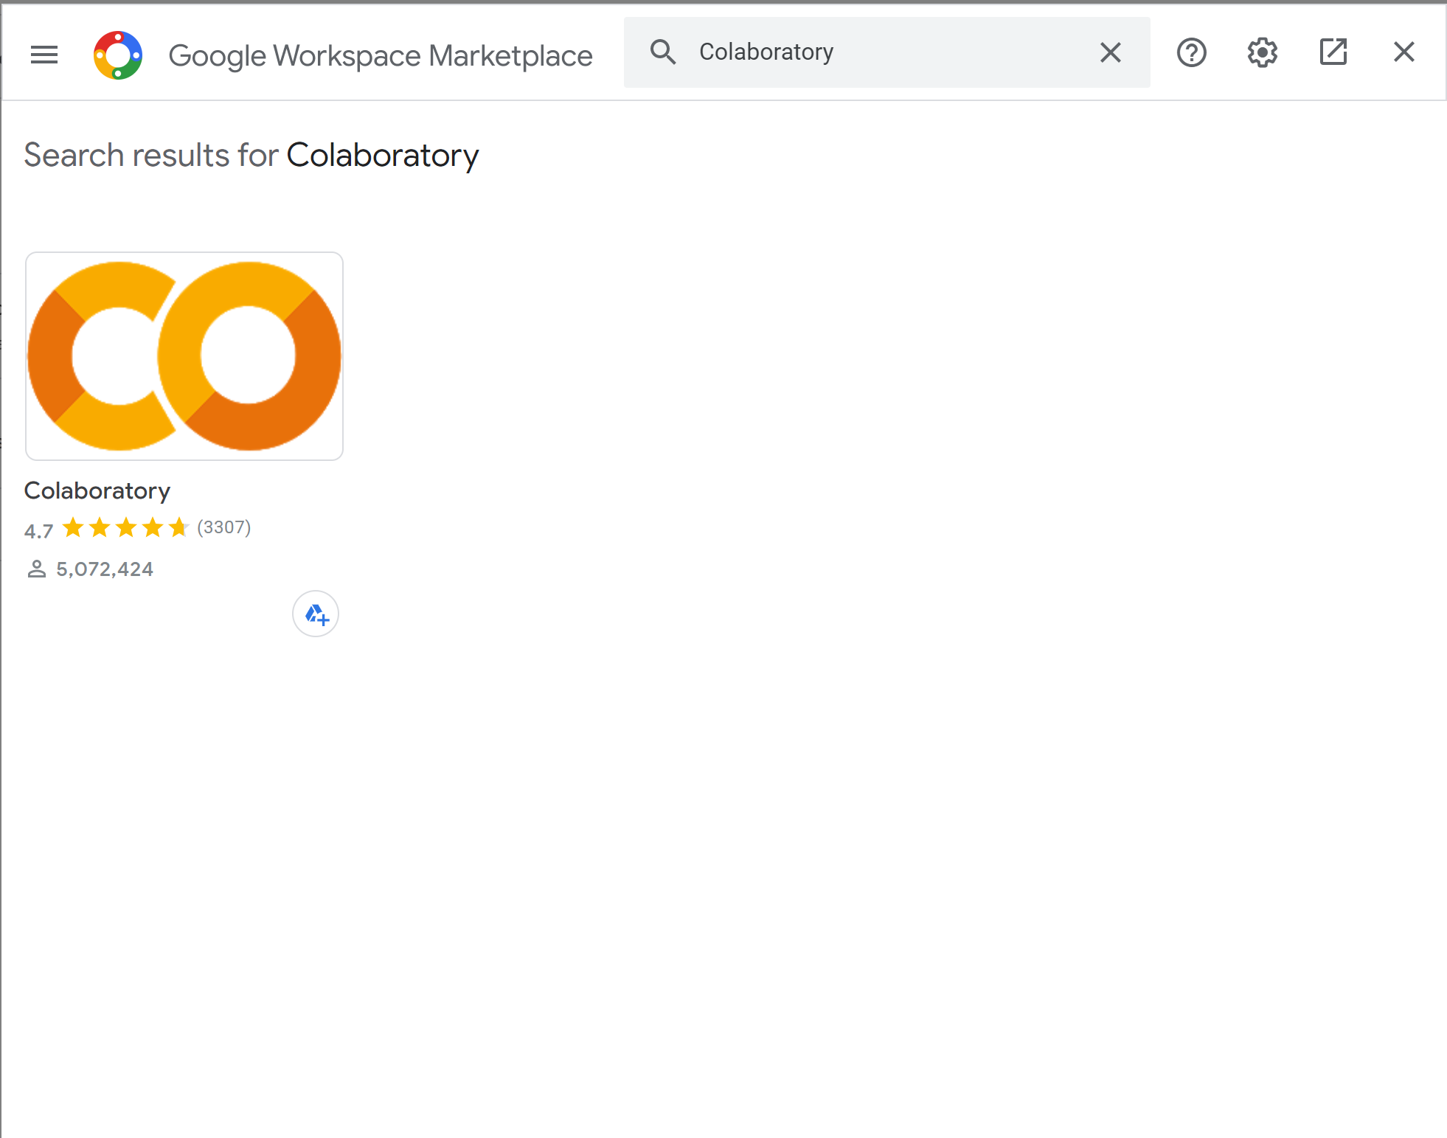
You may have to search for colaboratory at the top
Once you add it, a “Colab” folder will be created in your drive and colab scripts will be automatically created there
You can access other people’s scripts, or store your own scripts in different folders.

